Slide 1
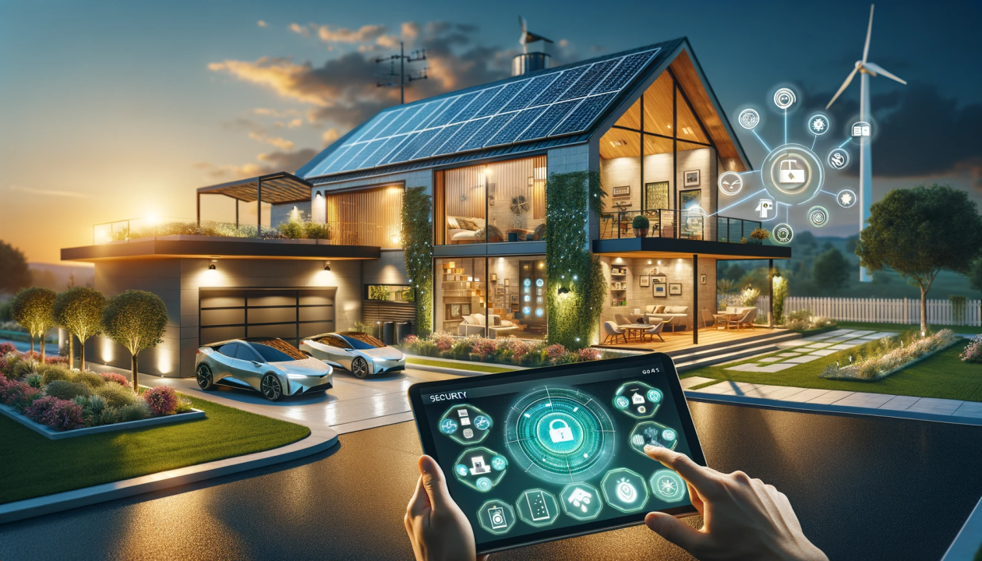
HOME ENERGY MANAGEMENT SYSTEM​
24-25J-222​

Slide 2
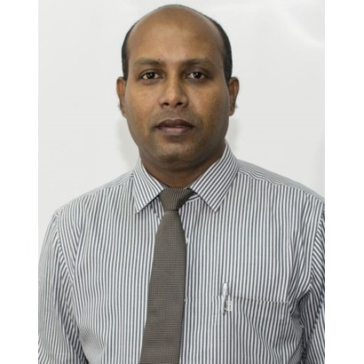
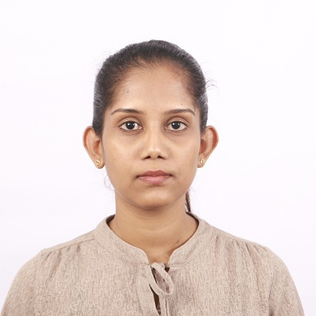
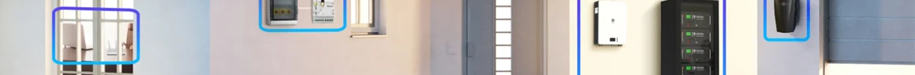
THE TEAM
PROF. SAMANTHA RAJAPAKSHA
MS. THAMALI KELEGAMA

Slide 3




THE TEAM
SITHUMINI K.G.P
ADHIKARI A. M. S. S
KODITHUWAKKU K.M.J
MAHANAMA K.T.D

Slide 4
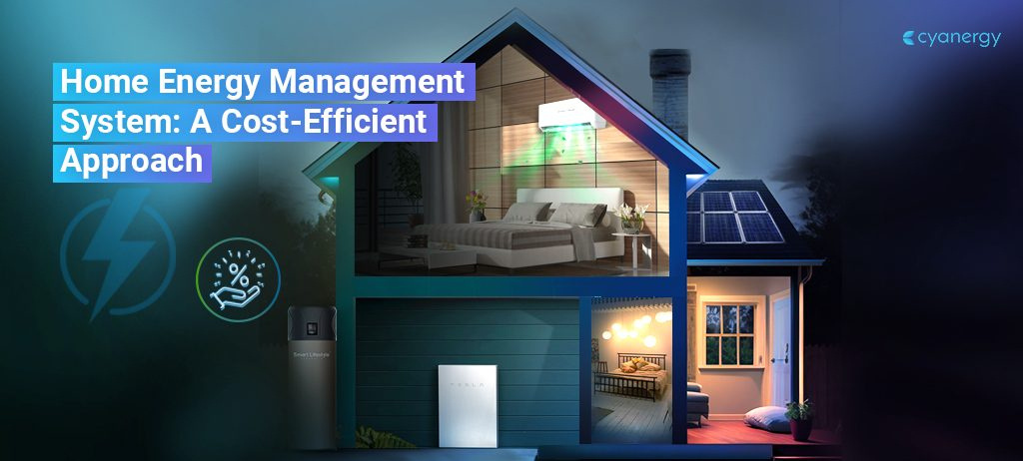

Introduction​
System Diagram​
Flow Chart
Tools & Technologies
Components
Commercialization
Gantt Chart​
Points For Discussion

Slide 5
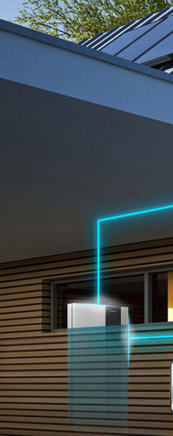
INTRODUCTION
Home Energy Management is essential for reducing costs and improving sustainability. Inefficient energy use leads to waste and higher expenses. Our goal is to develop an AI and IoT-based solution that optimizes energy consumption, manages solar power, gas, and fire detection, and ensures smart energy use with minimal human input.

Slide 6
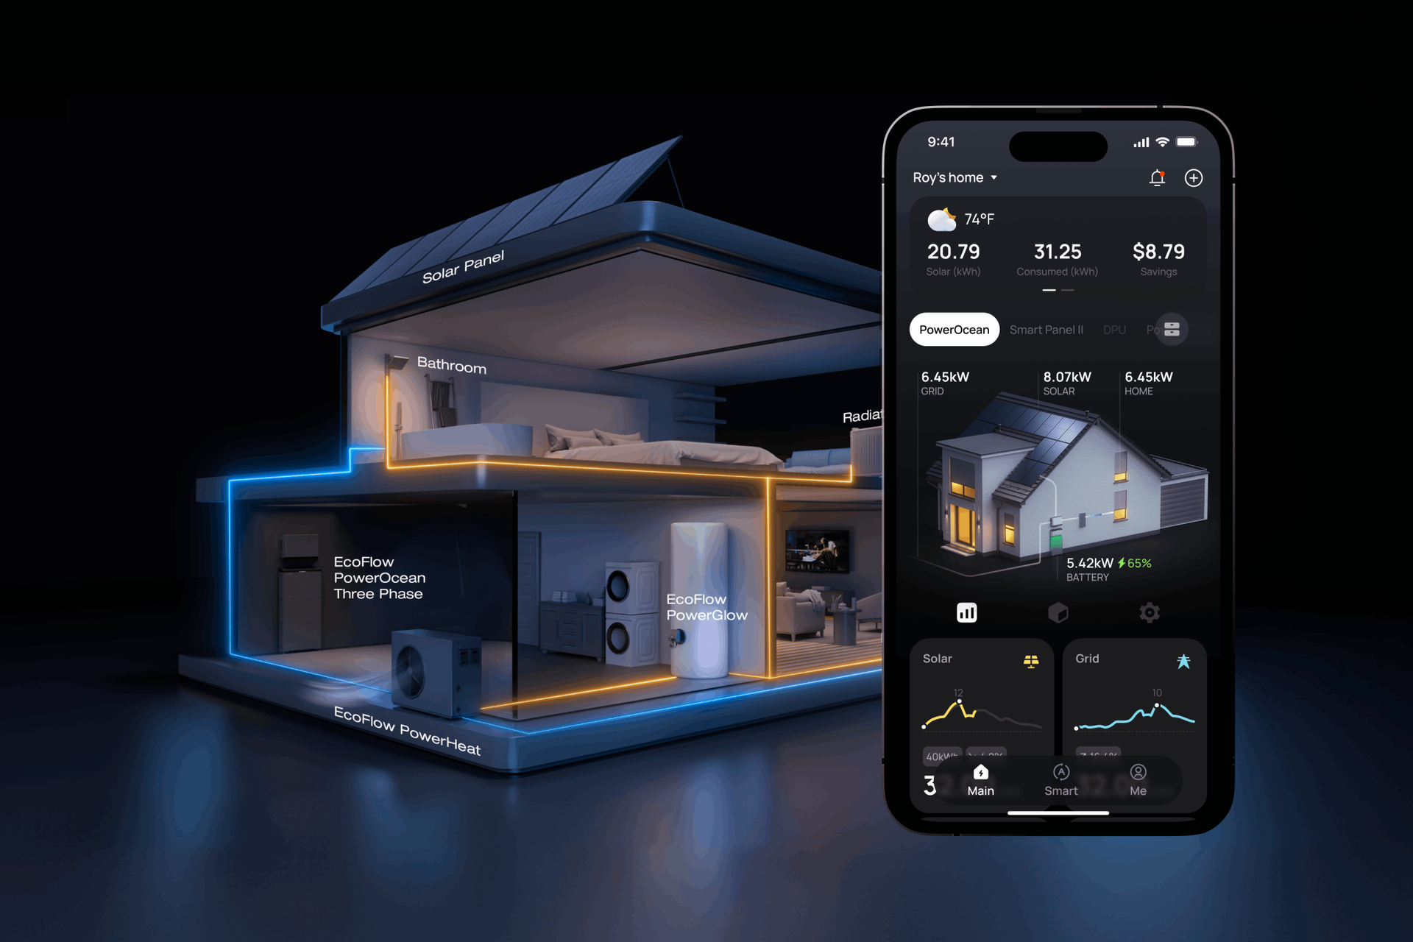
OBJECTIVES​
Develop an integrated home energy management system that addresses all components.​
​
Obtain a minimum 20% reduction in water and electricity consumption within six months by implementing the proposed system.​
​
Design and implement a prototype that is deployable in standard residential settings using cost-effective within one year.​

Slide 7
OBJECTIVES​
Enhance household safety by incorporating real-time features relevant to each function, ensuring with international safety standards.​
Conduct a pilot study within the one year to evaluate system performance and user satisfaction, aiming for at least an 85% positive feedback rate from participants.​

Slide 8
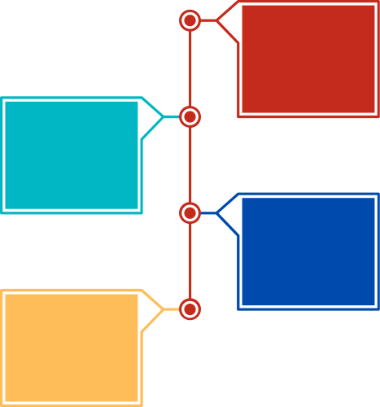
SUB OBJECTIVES
Home Energy Management System
Gas & Fire Management
Water Management
Solar Energy Management
Electricity Management

Slide 9
TOOLS & TECHNOLOGIES
Technologies
Algorithms
Tools
Python
React
Firebase
Node Js
Random Forest Learning​
Mixed-Integer Linear Programming​
GitHub
MS Planner

Slide 10
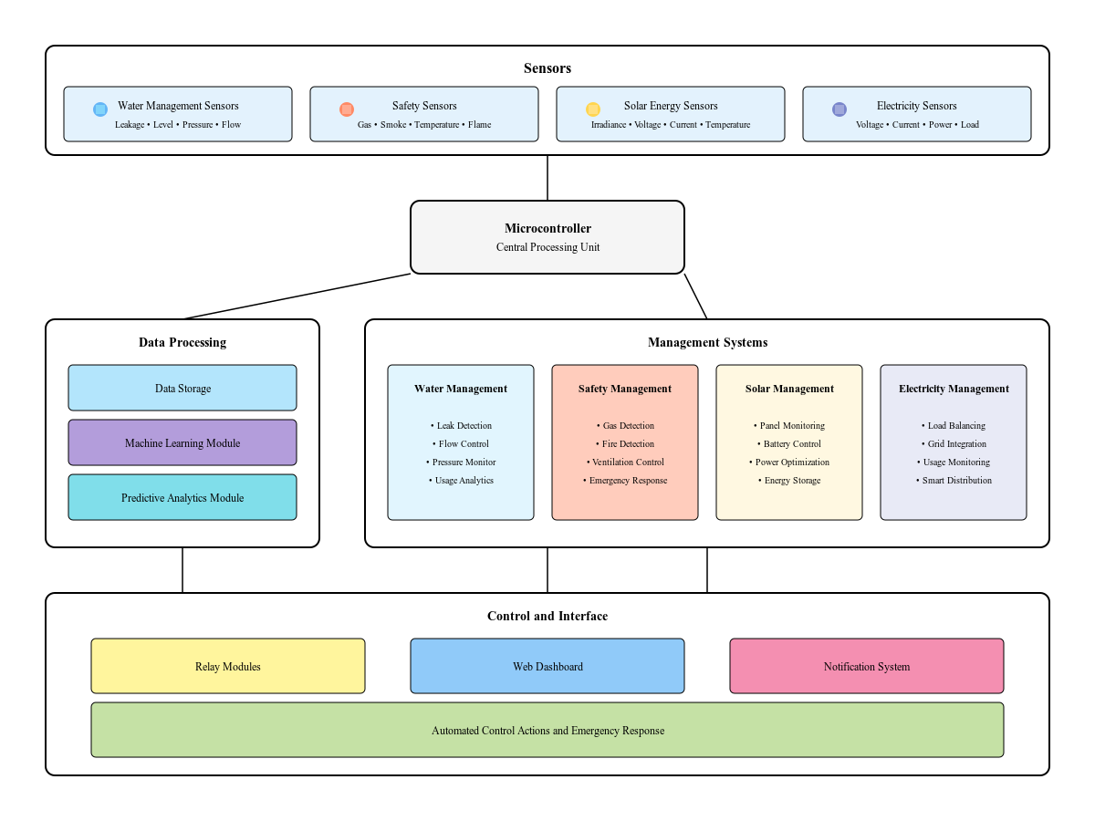
SYSTEM DIAGRAM

Slide 11

IT21173318​
ADHIKARI A. M. S. S​

Slide 12
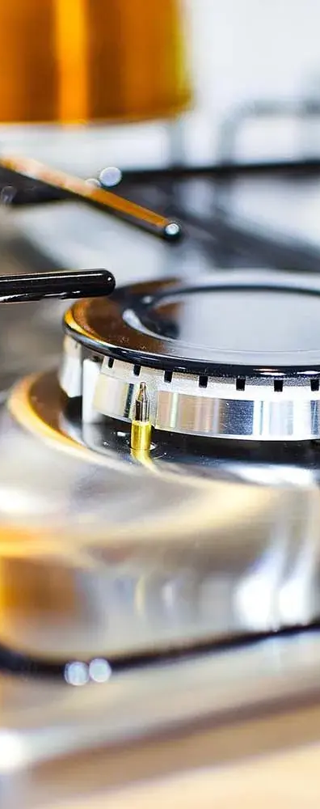
INTRODUCTION
System is designed to provide an optimized and user-friendly solution for managing gas and fire safety. It ensures that emergencies are handled efficiently without requiring human intervention.​
​
Automatic Gas Control: Gas flow can be controlled using voice commands. In case of a leak or emergency, the system promptly responds by shutting off the supply and notifying users.​
Fire Detection and Response: Sudden fires are detected using image processing and sensors. The system captures the event and initiates necessary safety measures.​
Real-Time Monitoring: It continuously monitors the system’s status, generates real-time reports, enables remote control of operations, and delivers optimal performance while prioritizing energy efficiency​

Slide 13
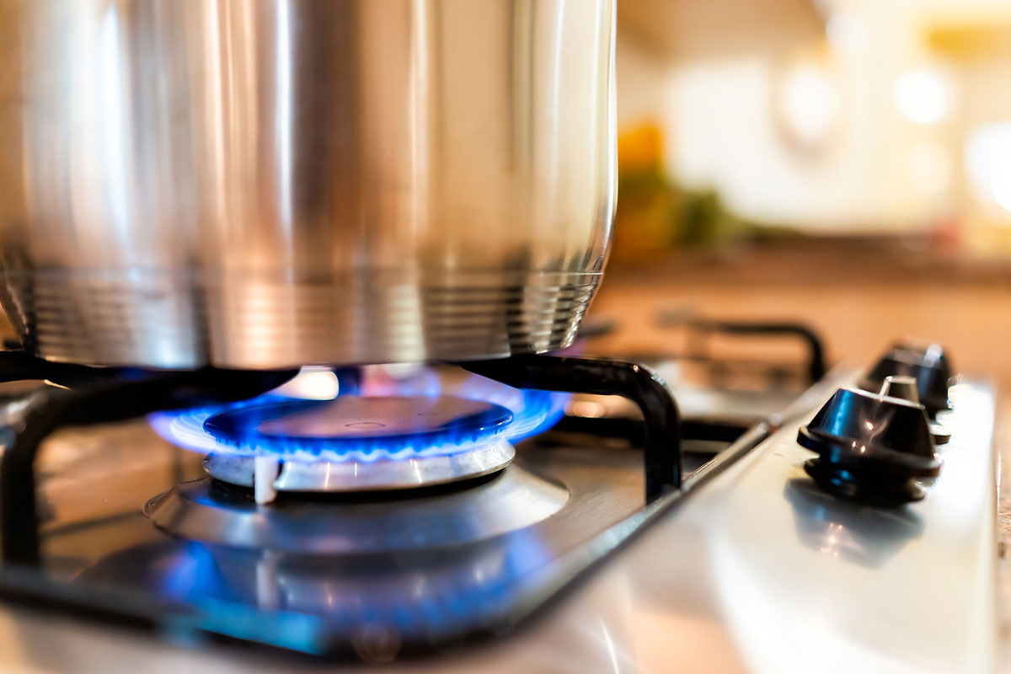
OBJECTIVES​
Developing a Responsive Web application for detect the emergency situation of the fire and gas of the home energy management system.​
​
This system will enhance safety and energy optimization by integrating real-time monitoring, automation, voice commands, and emergency response capabilities in user friendly way.​

Slide 14
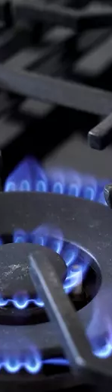

SUB OBJECTIVES
Control the gas appliance using voice commands (on/off) for immediate response.​
Detect the fire flames by analyzing heat signatures and fire patterns.​
​Sense the gas leakage using sensors identify the leakages and give emergency response.​
Monitor the real time status of the system and reduce unnecessary energy consumption by efficiently managing resources.​

Slide 15

RESEARCH QUESTION​
How can an optimized system using voice commands, advanced sensors, and image processing improve gas and fire detection and management in smart homes?​
How can the system ensure reliable operation during power outages or hardware failures?​
How effective is image processing in accurately detecting and responding to fire hazards?​
​
What are the challenges in scaling the system for larger or multi-unit residential buildings?​

Slide 16
SYSTEM DIAGRAM

Slide 17
PROGRESS OF THE SYSTEM​
Current work​
Future work​
Python
React
Firebase
Node Js
GitHub
MS Planner

Slide 18

IT21173936​
KODITHUWAKKU K.G.K.M.J​

Slide 19
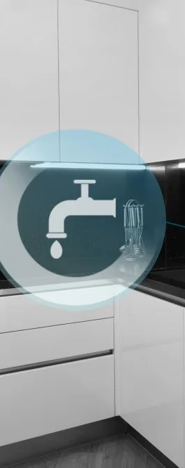
INTRODUCTION
Energy and water management are critical in modern buildings and industry due to increasing environmental concerns and rising operational costs.​
​
IoT systems offer predictive analytics, fault detection, and remote management improving efficiency and response times.​
​
Smart sensors and connected devices provide actionable insights into consumption patterns and anomalies.​
​
Cost savings from reduced water wastage and efficient energy usage are significant, improving the bottom line for businesses.​
​

Slide 20
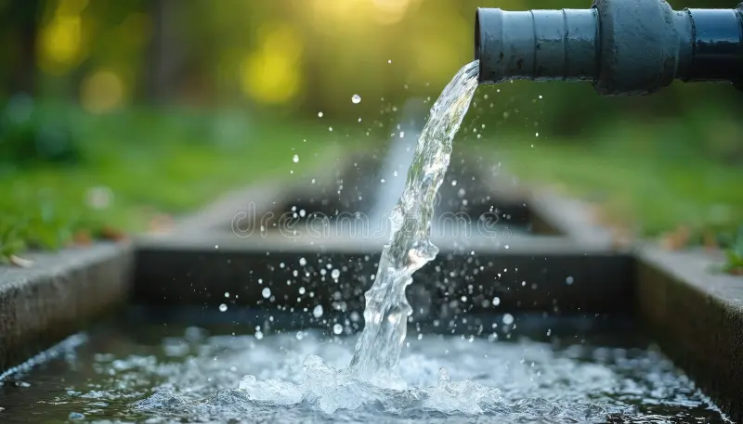
OBJECTIVES​
To develop an IoT-enabled water management system as part of a home energy management solution.​
To enhance water conservation and safety by detecting leaks, monitoring water levels, and identifying pipeline blockages in real-time.​
To integrate automation features such as automatic tank refilling and pressure monitoring to ensure optimal water usage.​​

Slide 21
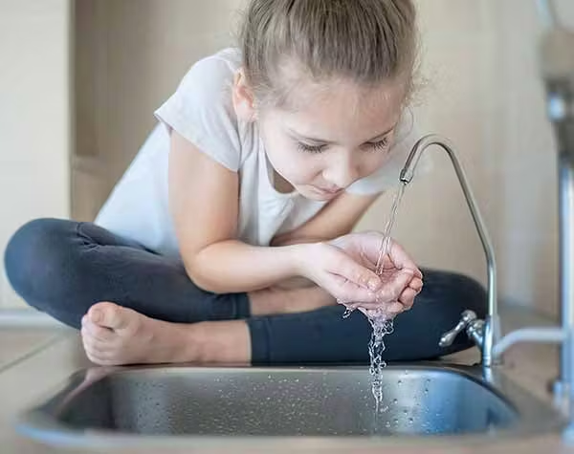
OBJECTIVES​
To provide users with a responsive web application for real-time monitoring, alerts, and actionable insights in a user-friendly manner.​
To contribute to sustainable resource management by preventing water wastage and reducing manual intervention.

Slide 22
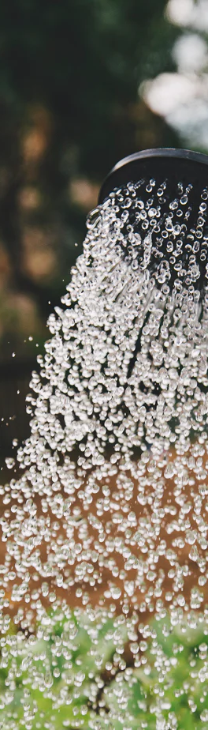

SUB OBJECTIVES
Real-time Water Monitoring​
Leak Detection in water values​
Energy Management and Monitor the status​
Monitor the Real-time Status​

Slide 23

RESEARCH QUESTION​
How can IoT be used to optimize water use and​ management in energy systems?​
How effective are IoT-based leak detection systems in reducing water wastage compared to traditional methods?​
How can IoT technologies be leveraged to enhance the efficiency of water management systems in industrial settings?​

Slide 24
SYSTEM DIAGRAM

Slide 25
FLOW​
ChART​

Slide 26
PROGRESS OF THE SYSTEM​
Current work​
Future work​
Python
React
Firebase
Node Js
GitHub
MS Planner

Slide 27
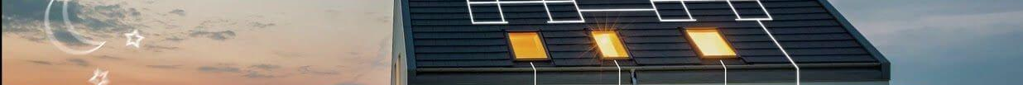
IT21170584
SITHUMINI K.G.P

Slide 28
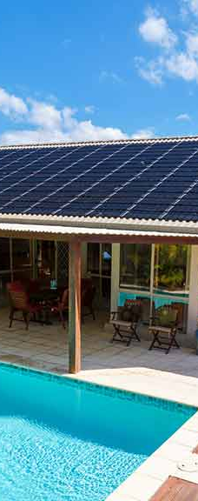
INTRODUCTION
Monitoring, managing, maintaining, and optimizing energy usage while integrating predictive weather insights. Provide users with a summary of the power usage and generation based on an analysis of the power.​

Slide 29
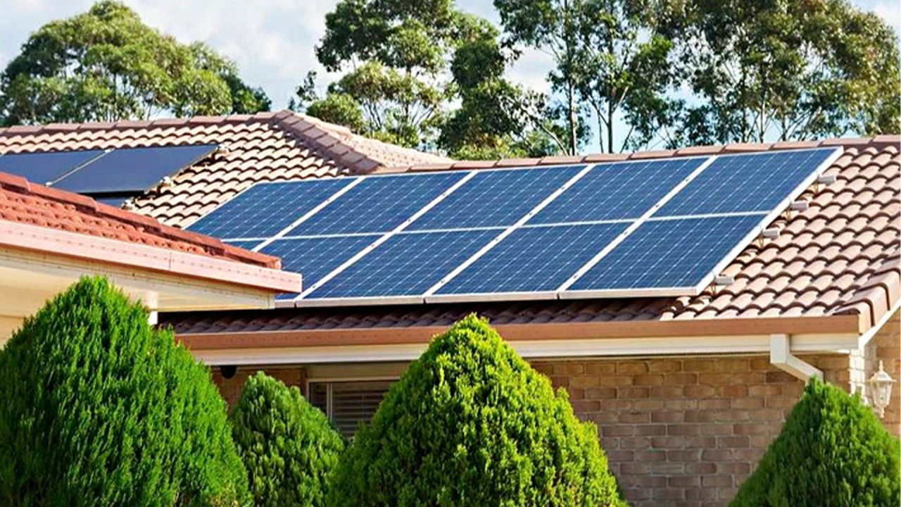
OBJECTIVES​
Implement an efficient solar energy management system that monitors, manages, maintains, and optimizes energy usage while integrating predictive weather insights, enabling users to analyze power usage and generation for informed decision-making with user friendly interface​

Slide 30
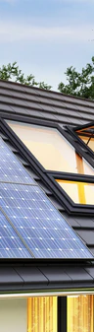

SUB OBJECTIVES
Monitoring and Data Collection​
Energy Usage Optimization​
Integration of Predictive Weather Insights​
User Interface and Reporting​
System Scalability​

Slide 31
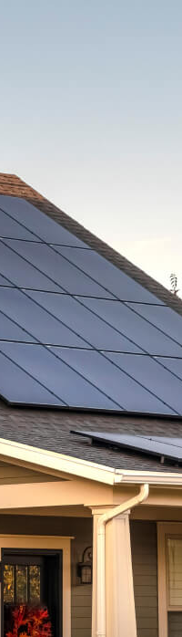
RESEARCH GAP​
Real-Time Monitoring and Integration​
Integration of Multiple Energy Components​
Poor user requirements​
Limited Optimization for Dynamic Environments​
Scalability Issues​

Slide 32
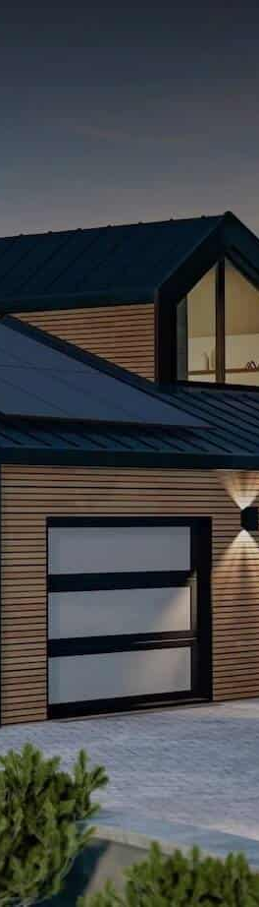
RESEARCH QUESTION​
Implement solar management project within 1 year​
Can a user-friendly interface significantly influence the adoption and usability of solar energy management systems?​
What is the impact of real-time monitoring on reducing energy waste in solar-powered homes?​
How does the inclusion of predictive weather analytics improve energy savings compared to system​

Slide 33
SYSTEM DIAGRAM

Slide 34

PROGRESS OF THE SYSTEM​
Model Creation & Train​
IOT
Interface
Python
React
Firebase
Node Js
GitHub
MS Planner

Slide 35

IT21301490​
MAHANAMA K.T.D​

Slide 36

INTRODUCTION
The project focuses on creating a smart system to manage energy use in homes. It will automatically control devices based on real-time data to reduce energy waste and lower bills. This smart management will not only lower energy bills but also contribute to more sustainable living.​

Slide 37

OBJECTIVES​
develop an AI-based system for managing electricity consumption in homes. The system will monitor electricity usage through sensors, analyze data, and automatically adjust devices to reduce energy wastage and lower costs.​

Slide 38
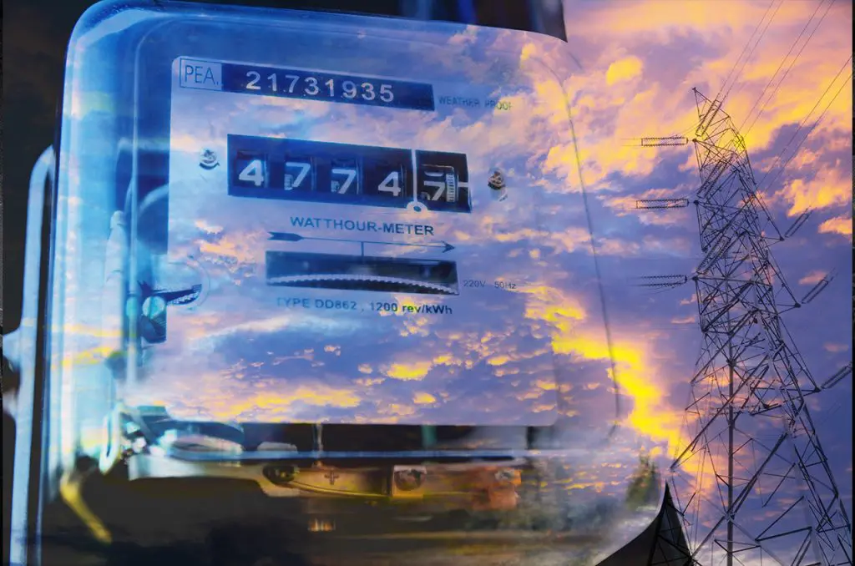

SUB OBJECTIVES
Energy Usage Monitoring​
Automated Energy Optimization
Energy-Saving Recommendations​
Cost Reduction
User Customization

Slide 39
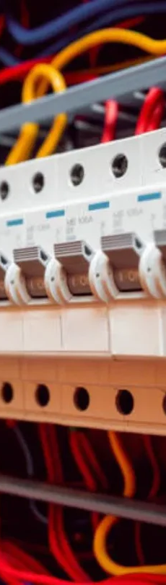
RESEARCH QUESTION​
How can AI be used to optimize electricity usage in residential homes?​
What are the most effective ways to reduce energy waste in homes?​
How can user preferences be integrated into an energy management system?​
How can real-time electricity consumption data be utilized to lower energy costs?​

Slide 40
SYSTEM DIAGRAM

Slide 41
PROGRESS OF THE SYSTEM​
Current work​
Future work​
Python
React
Firebase
Node Js
GitHub
MS Planner

Slide 42
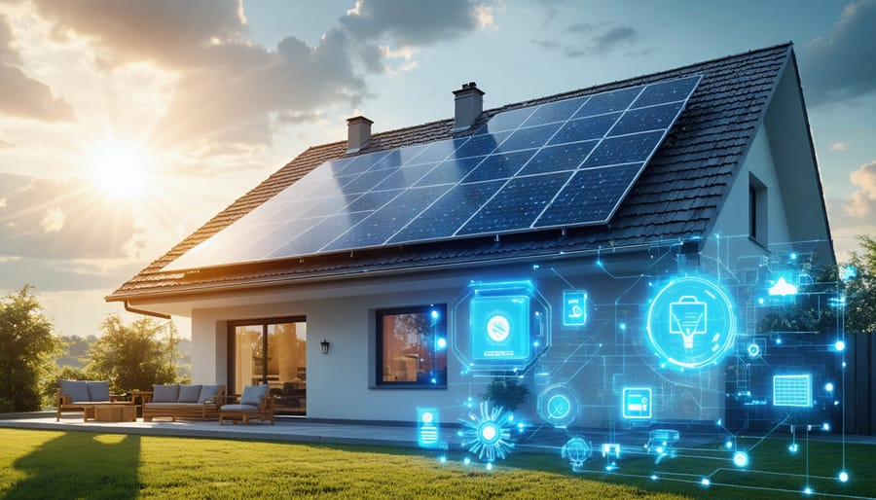
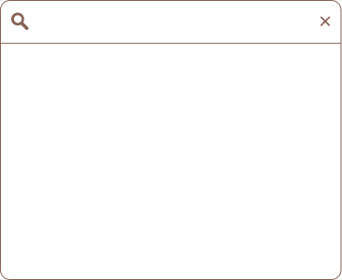
COMMERCIALIZATION
How to Sell
Target Audience
Find Audience
Create good advertisement
Seminars
Homeowners​
Property Managers​
Utility Companies​
Version
Marketplace
Basic​
Industrial​
Premium
Direct Sales​
E-commerce platforms​
Utility Company Partnerships

Slide 43


WORK BREAKDOWN STRUCTURE​
Weakness
Threats
The creative idea often originates from a spark of inspiration that can come from a variety of sources.
The creative idea often originates from a spark of inspiration that can come from a variety of sources.
Strengths
Opportunities
The creative idea often originates from a spark of inspiration that can come from a variety of sources.
The creative idea often originates from a spark of inspiration that can come from a variety of sources.

Slide 44
GANTT CHART

Slide 45
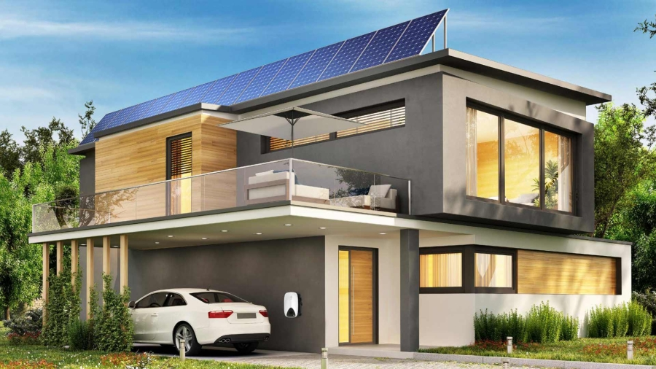
ANY QUESTION?

Slide 46
THANK YOU...!
24-25J-222​

